Slide 1

Unveiling Coffee Shop Performance
A deep dive into sales data from three New York City branches reveals key insights and actionable strategies for growth and efficiency.

Slide 2
Agenda
1
2
3
Dashboard Overview
Key Insights
Product Performance
Introduction to the dataset and branches.
Highlighting critical sales trends and patterns.
Analyzing top-selling categories and underperformers.
4
5
Strategic Questions
Actionable Recommendations
Formulating inquiries for deeper analysis.
Proposing data-driven improvements.

Slide 3
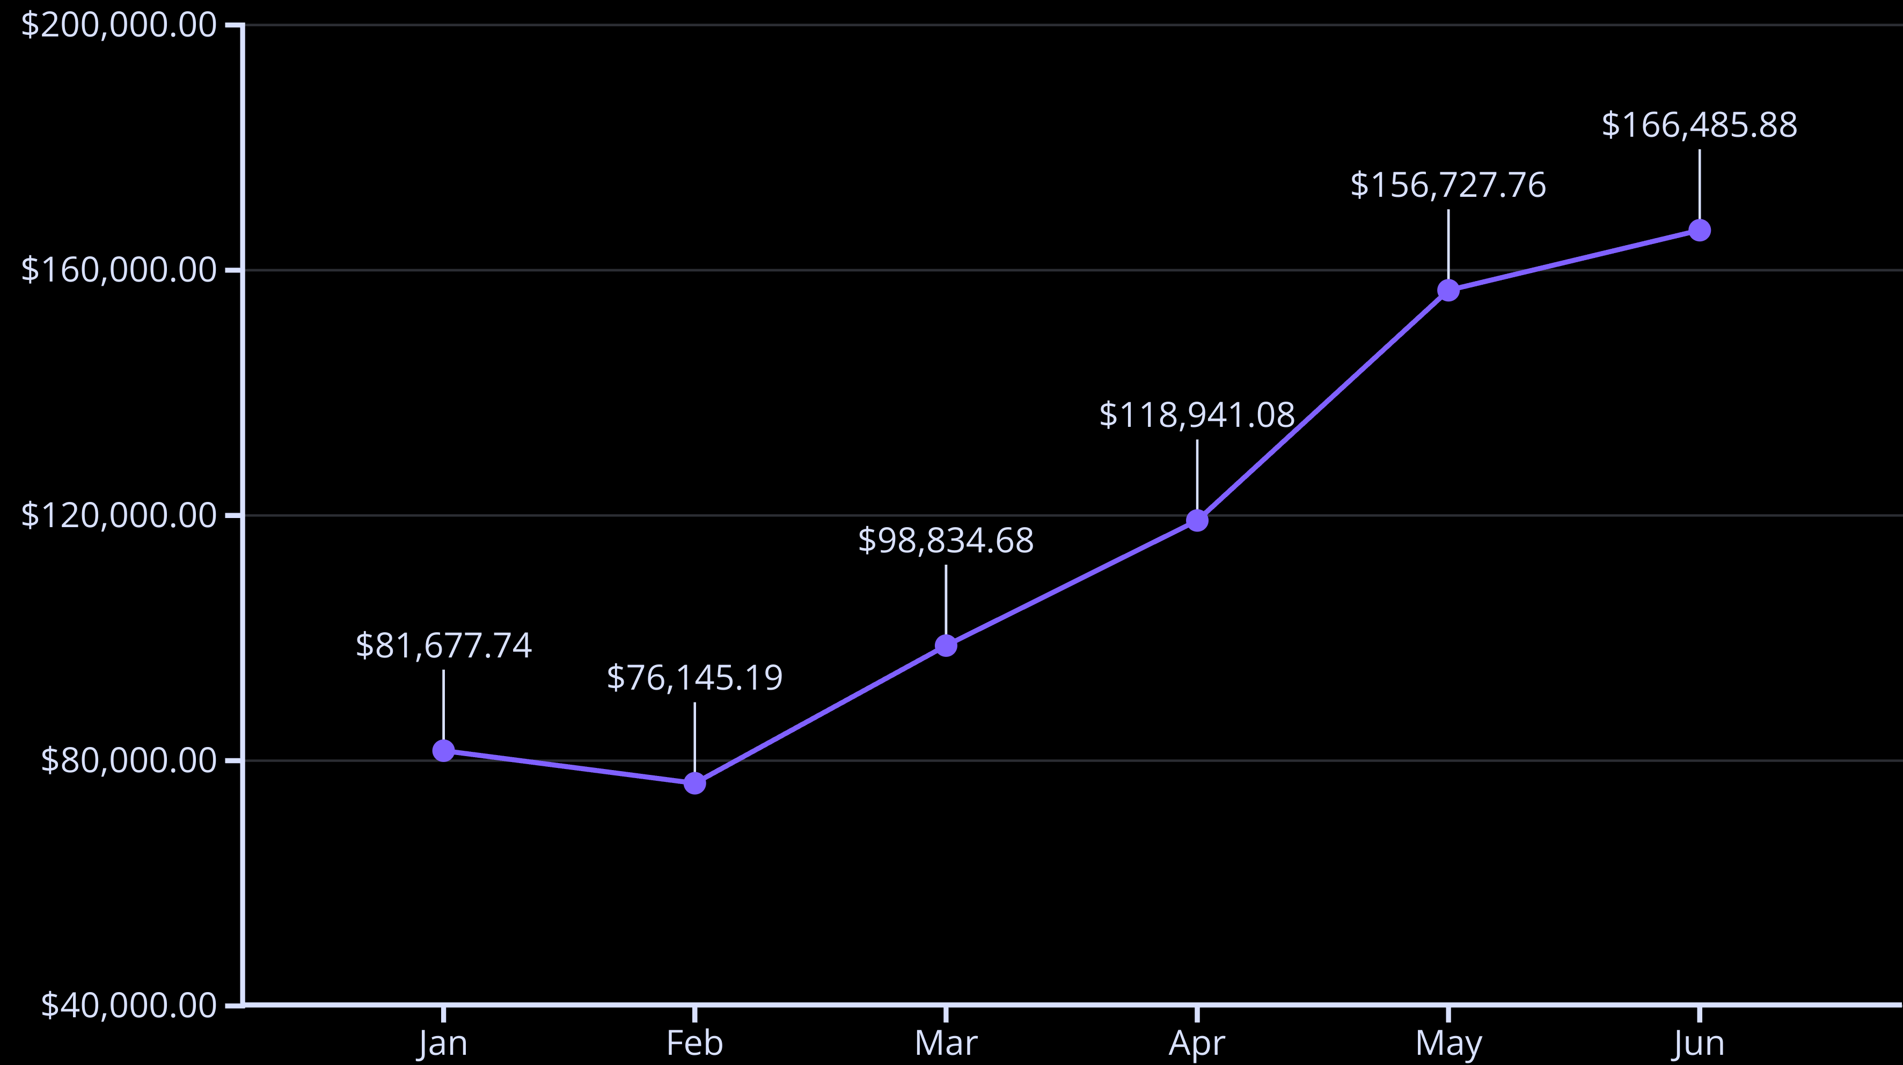
Revenue Trends: February Drop
Our analysis shows a notable decrease in revenue during February across all branches. This trend warrants further investigation to understand its root causes, such as seasonal variations, marketing campaigns, or operational factors.

Slide 4
Location-Specific Sales Peaks
Sales performance varies significantly by location and day of the week, indicating distinct customer behaviors across our New York City branches.
Lower Manhattan
Hell's Kitchen
Astoria
Monday is the strongest selling day, likely due to a large influx of office workers starting their week.
Sales are consistently strong throughout the week, with a slight dip only on Saturdays. This suggests a more stable, local customer base.
Friday, Thursday, Wednesday, and Monday show similar high transaction levels, with a noticeable gap to the rest of the week, possibly reflecting commuter patterns.

Slide 5



Peak Selling Hours: Morning Rush
The busiest period for transactions is consistently between 7 AM and 11 AM across all locations, followed by a decline in activity from 11 AM to 5 PM. Evening transactions are generally very low.
7 AM - 11 AM
11 AM - 5 PM
After 5 PM
Highest transaction volume, likely driven by morning commuters and breakfast crowds.
Gradual decrease in transactions, indicating a slowdown after the morning rush.
Very low transaction activity, especially in Astoria, where there are no transactions after 8 PM.

Slide 6
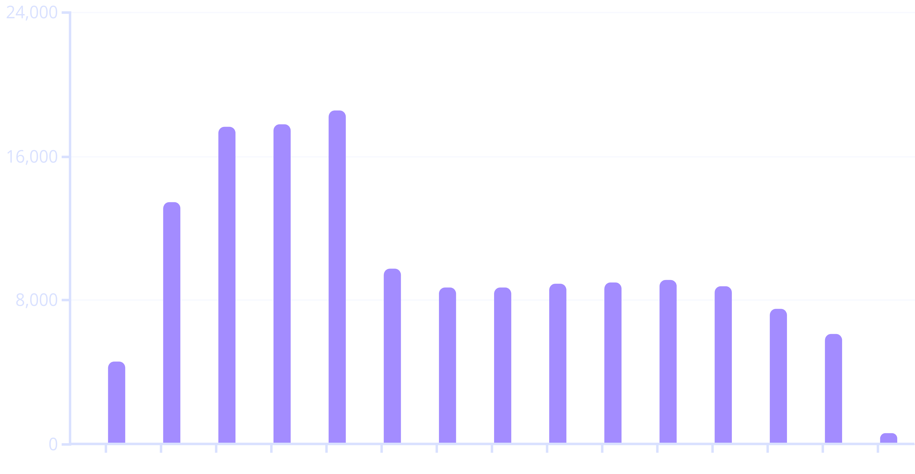
Transaction by Hour
6
7
8
9
10
11
12
13
14
15
16
17
18
19
20
Hours
Quantity

Slide 7



Top-Selling Product Categories
Coffee and Tea dominate our sales, reinforcing their status as our core offerings. Other product categories currently have significantly lower transaction volumes.
Coffee
Tea
Other Categories
Our primary revenue driver, appealing to daily commuters and coffee enthusiasts.
A strong complementary category, catering to diverse preferences.
Require review to understand reasons for low transactions.

Slide 8
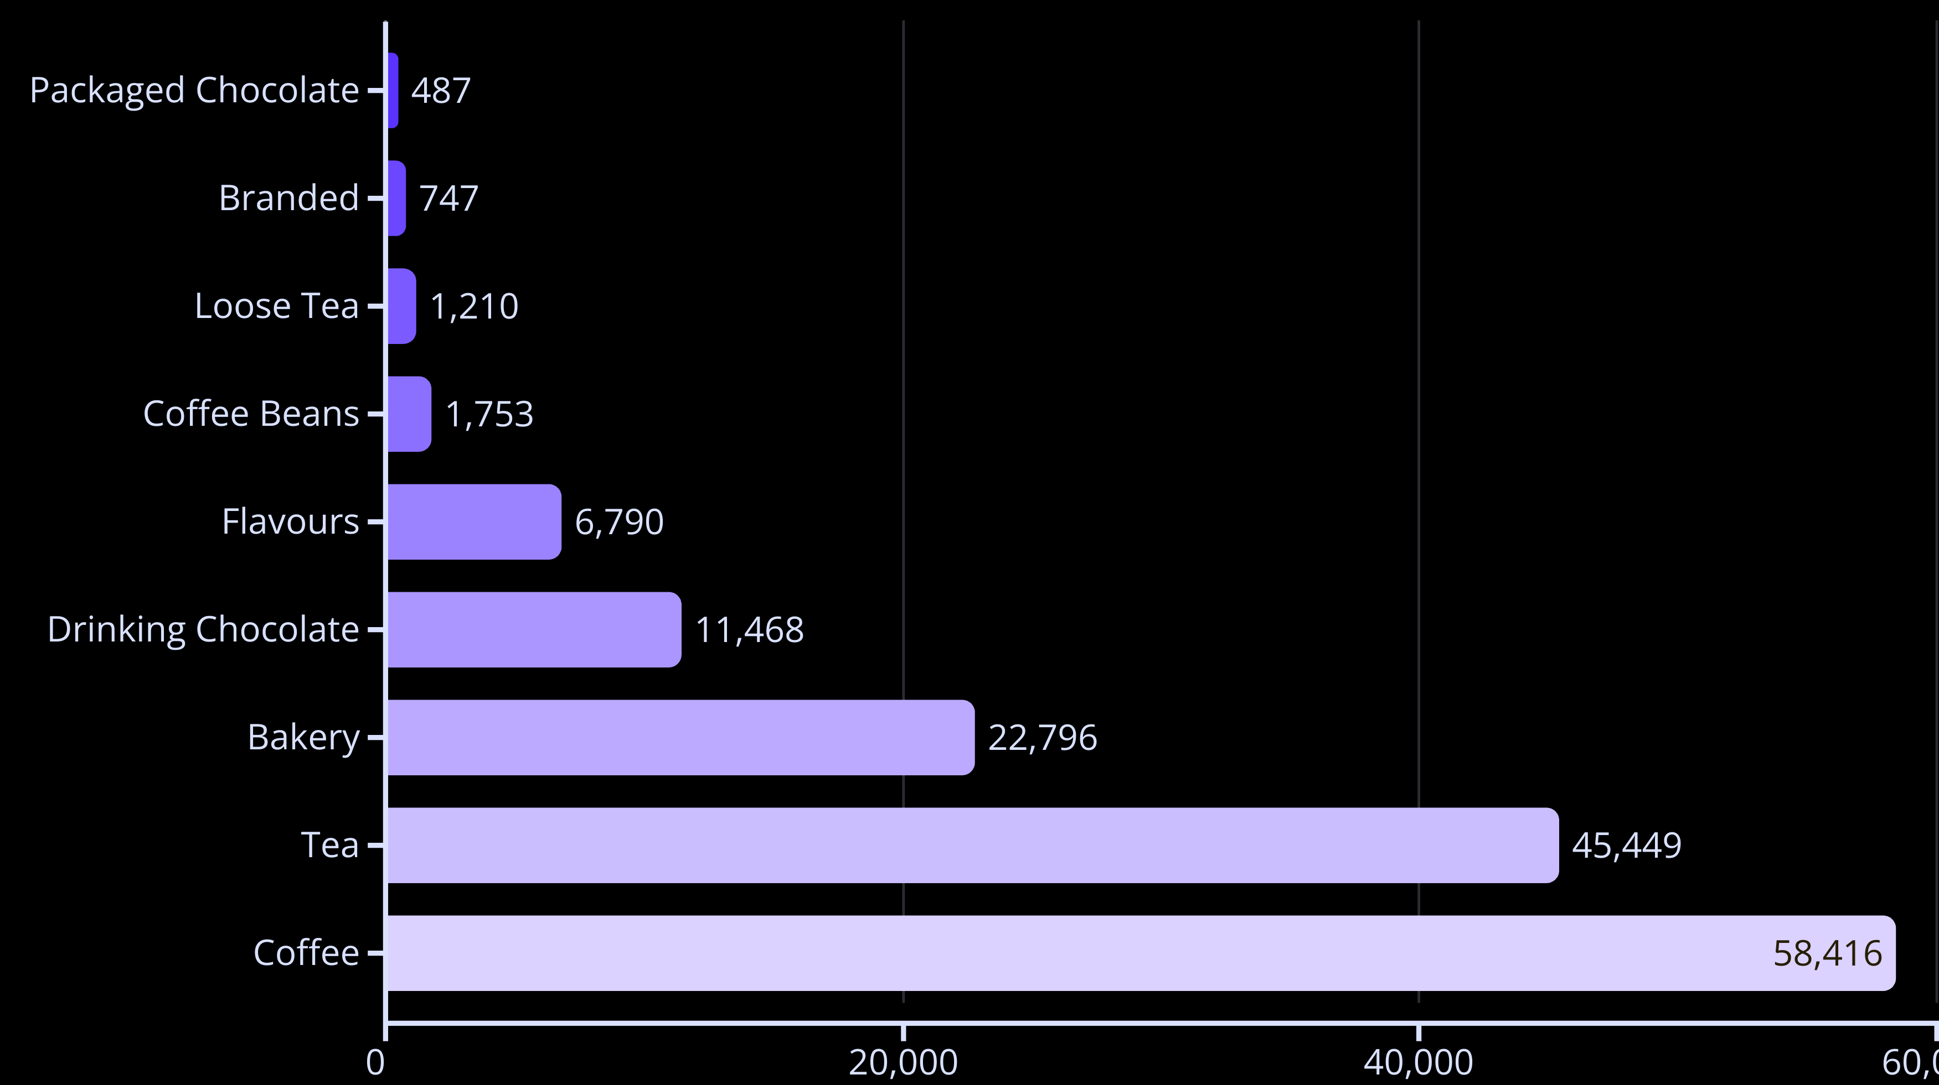
Top Selling Statistics

Slide 9
Underperforming Products: A Closer Look
Several product categories, despite their pricing, show surprisingly low transaction numbers, signaling a need for strategic intervention.
Coffee Beans
Branded/Loose Tea & Packaged Chocolate
Flavors
Low transactions may be attributed to their higher price point. Customers might prefer purchasing brewed coffee over beans for home use.
Even with a very cheap price, transactions for added flavors are low. This might suggest customers prefer plain coffee/tea or are unaware of the flavor options.
Despite their low price, these items have very low transactions. This could indicate a lack of visibility, poor merchandising, or low demand.

Slide 10
Strategic Questions for Growth
What are the underlying reasons for low transactions in non-coffee/tea product categories?
How can we increase sales of coffee beans, branded/loose tea, packaged chocolate, and flavors?
Are there opportunities to optimize pricing for our high-performing coffee and tea products?
How can we better align operating hours and staffing with customer demand patterns?

Slide 11
Actionable Recommendations: Optimizing Operations
1
Adjust Pricing for Core Products
2
Optimize Astoria's Operating Hours
3
Refine Lower Manhattan's Operating Hours
Consider a slight price increase for Coffee and Tea due to their consistently high transaction volumes and strong demand, maximizing revenue without impacting customer loyalty.
Decrease working hours in Astoria to close at 8 PM instead of 9 PM, as transactions are negligible after this time, improving efficiency and reducing labor costs.
Adjust working hours in Lower Manhattan to close at 7 PM instead of 9 PM, given the very low transaction volume in the late evening, leading to more efficient staffing.

Slide 12
Actionable Recommendations: Enhancing Service
Increase Morning Staffing
Promote Underperforming Products
Investigate February Dip
Increase the number of employees during the 7:00 AM to 11:00 AM shift across all branches to handle the very high selling volume and ensure excellent customer service during peak hours.
Conduct a deeper analysis into the February revenue drop to identify specific contributing factors and develop strategies to mitigate similar declines in the future.
Implement targeted marketing and merchandising strategies for coffee beans, specialty teas, packaged chocolate, and flavorings to boost their visibility and sales.

